Slide 1
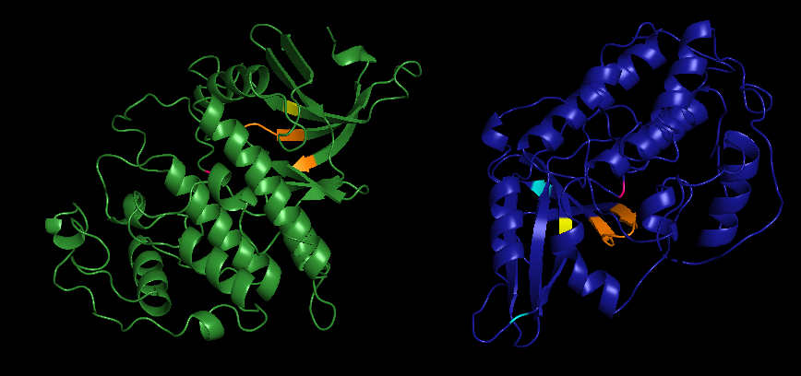
Does targeting YBR160W suppress cancer proliferation?
YBR160W (yeast)
CDK4 (human)
Group I
Notes:
IMAGE of CDK4 and YBR160W

Slide 2
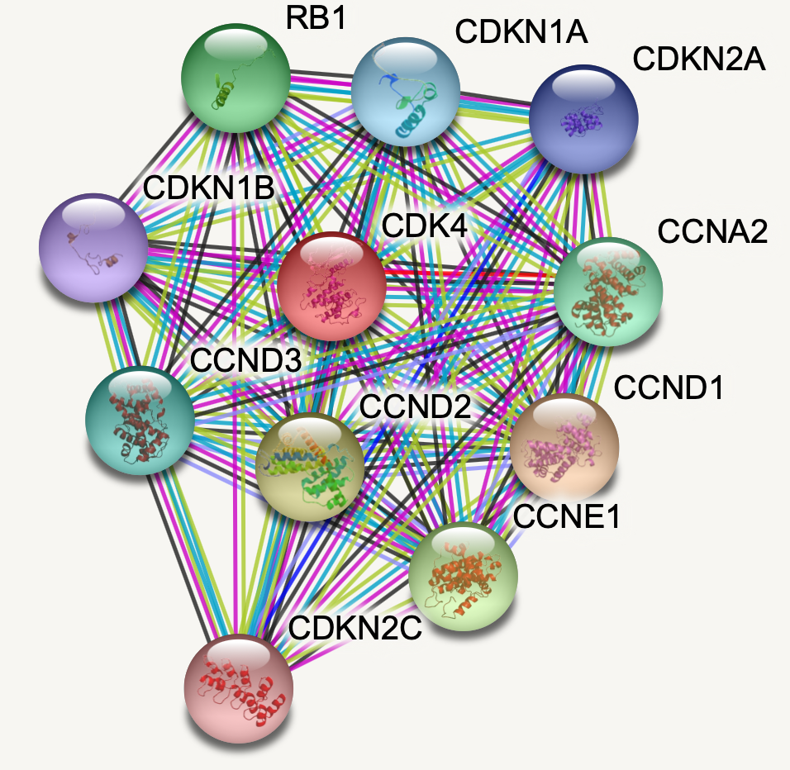
Introduction: Background and Aims
Notes:
PUT STRING NETWORK OF CDK4 HERE

Slide 3
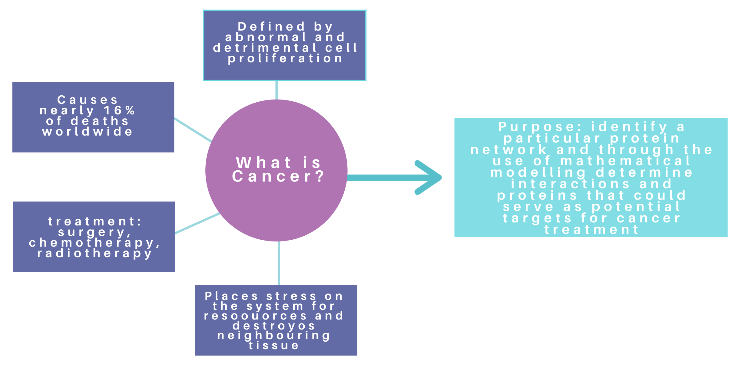
Figure 1: Schematic summary of cancer and our project purpose. This figure highlights the importance of cancer research as it has clear and detrimental effects on those who suffer from it. From this understanding of cancer we developed our project purpose and aims

Slide 4
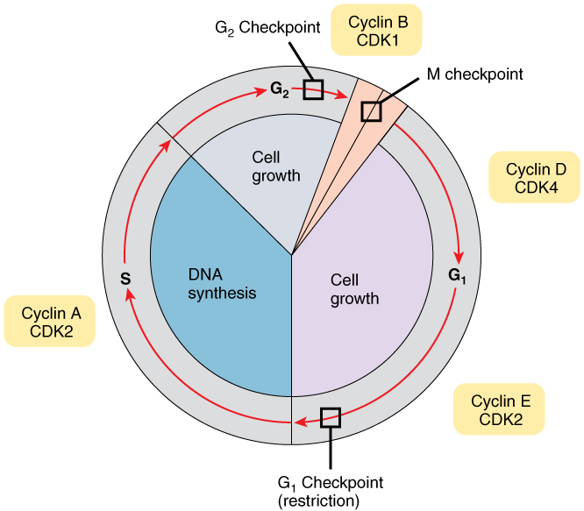
Cell Cycle Proteins
The cell cycle is in charge of the proliferation of the cell, allowing a single cell to double its genomic content and create a daughter cell.
There are four phase to the cell cycle
G1, where the cells increase in size and cellular contents are duplicated
S phase where DNA is replicated
G2, where the organelles and proteins develop in preparation for cell division
M phase which included mitosis and cytokinesis.
To manage the transition between these stages, the cell employs proteins complexes to trigger various mechanisms [1]
Most of these complexes consist of a cyclin dependent complex that pairs with a cyclin.
Figure 2: Schematic representation of cell cycle phases. Image taken from https://en.wikipedia.org/wiki/Cell_cycle_checkpoint

Slide 5
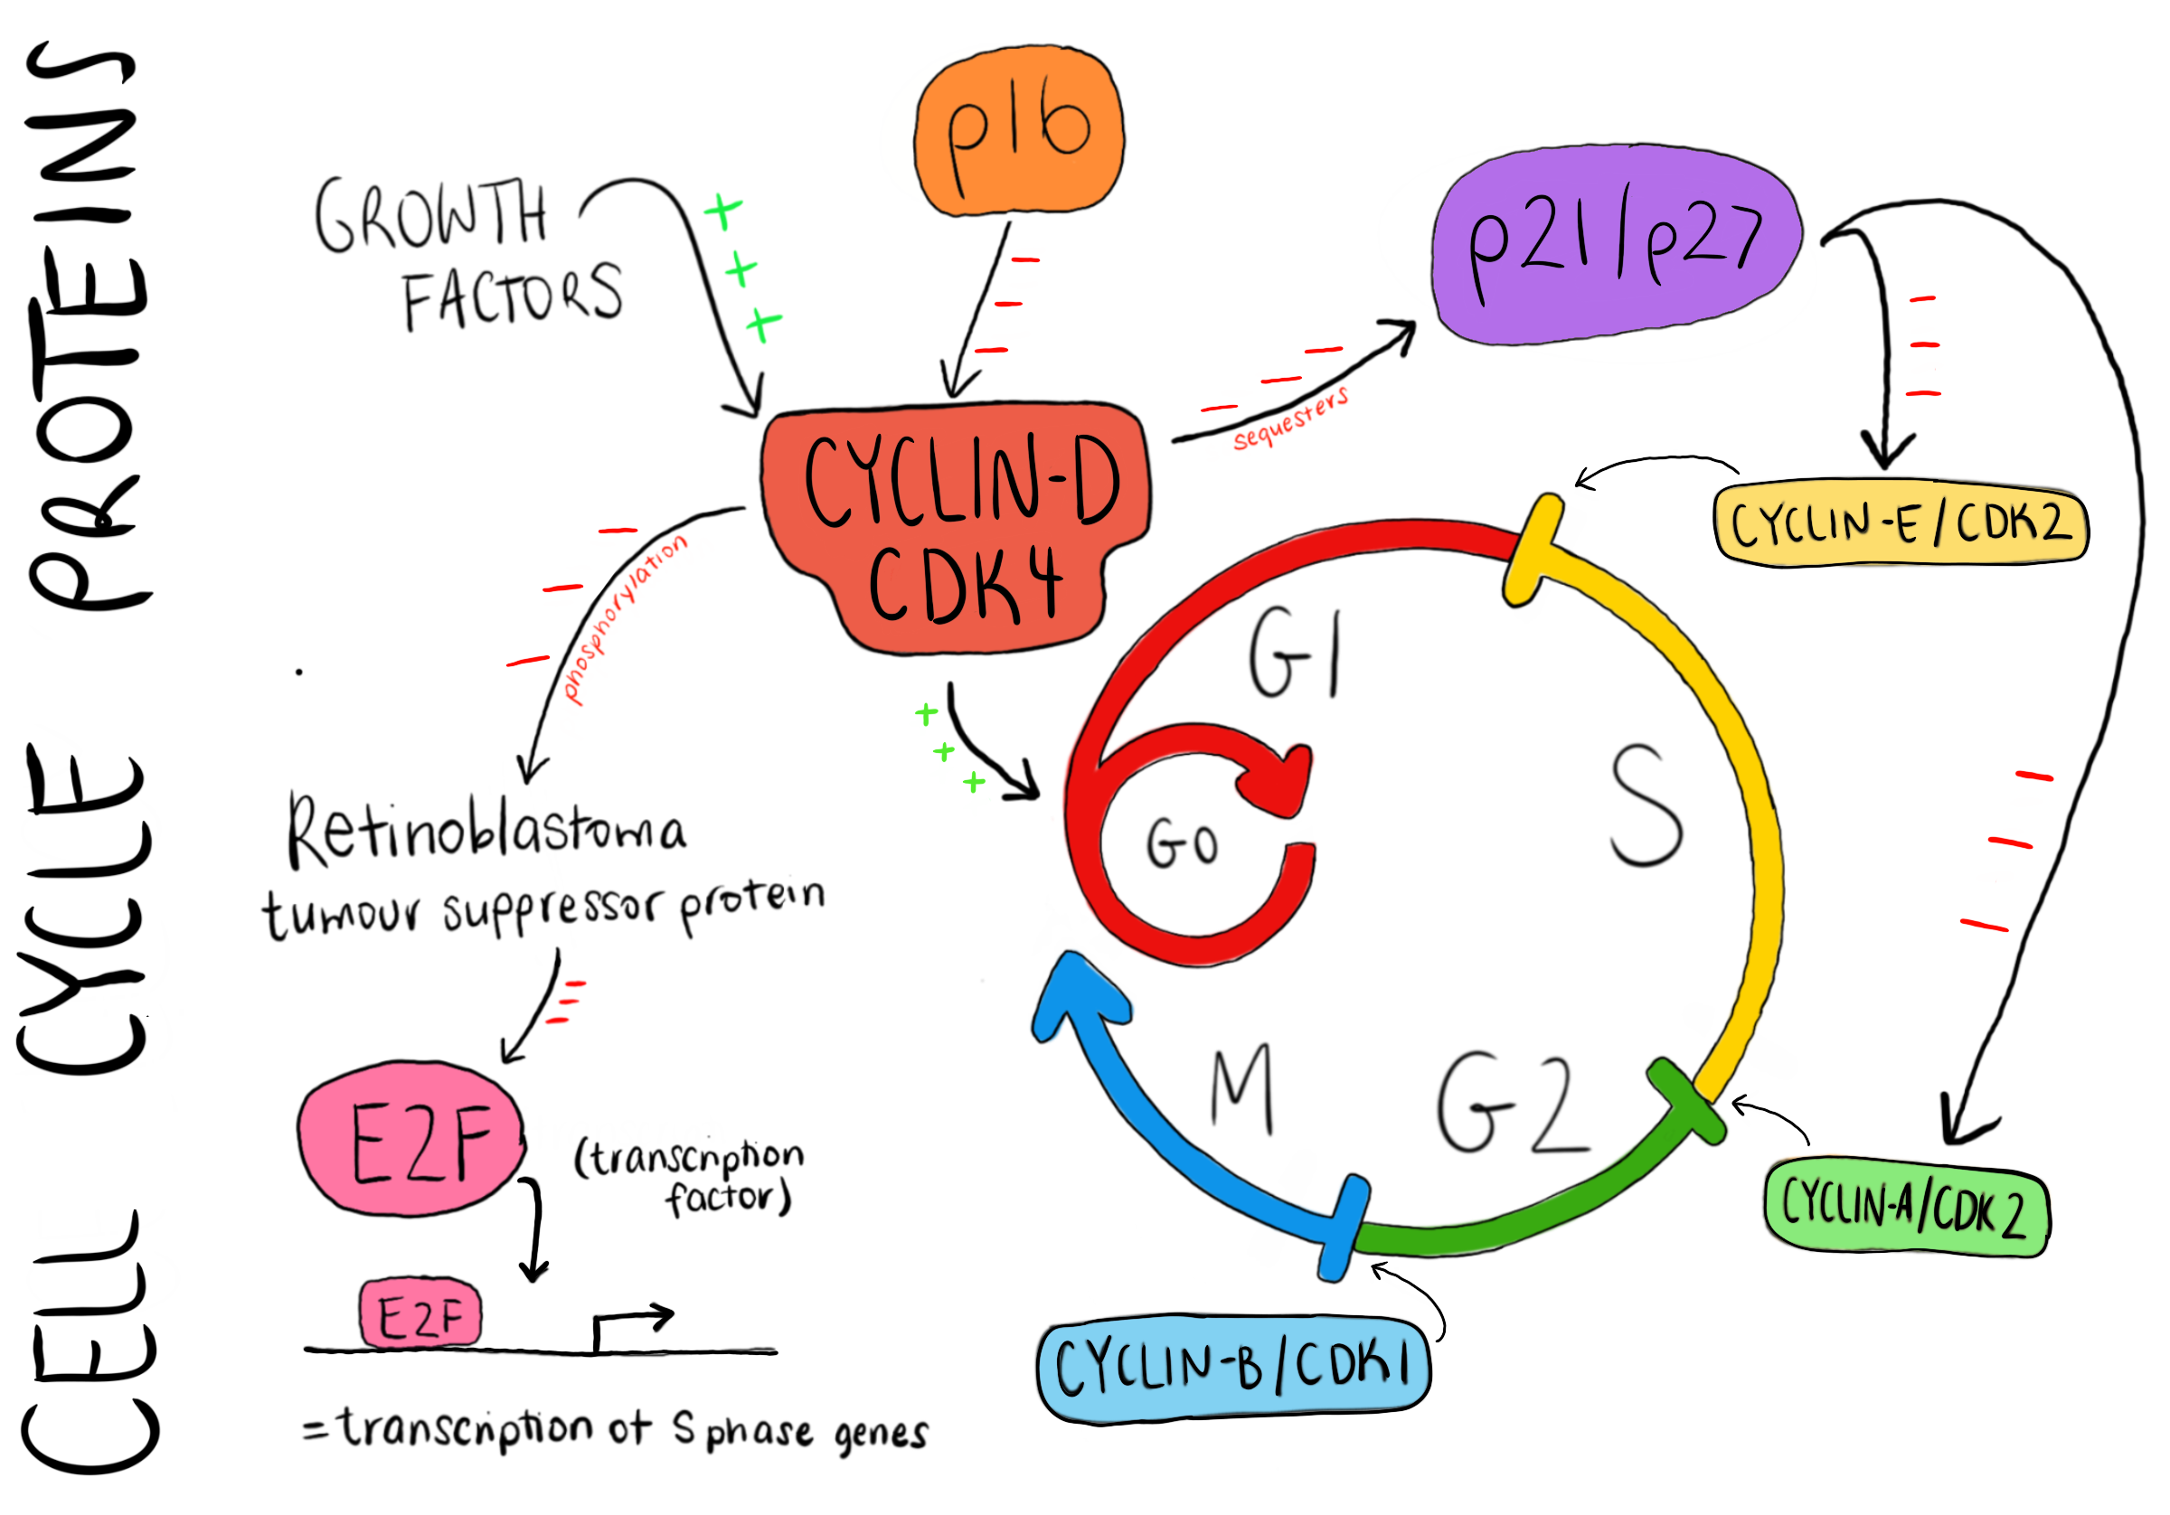
What is CDK4?
CDK4 - forms complex with cyclin D1 to manage transition between G1 and S phase of cell cycle
CDK4 is activated by mitotic growth factors and triggers the transition through two mechanisms [1]
phosphorylation of retinoblastoma tumour suppressor protein (enables transcription factor E2F to activate S phase genes)
sequesters p21/p27 to remove its inhibitory effect on cyclin E/CDK2 complex
The schematic found on the left was created by one of the biochemistry students to cohesively understand CDK4’s role in the cell cycle
We also generated a sketchfab of the CDK4 structure to help us understand how the proteins structure influences its function (https://skfb.ly/6Wtvz)
Figure 3: Self-generated schematic of CDK4’s role within the cell cycle.
Notes:
Put this image here?
Sketchfab around this slide?

Slide 6
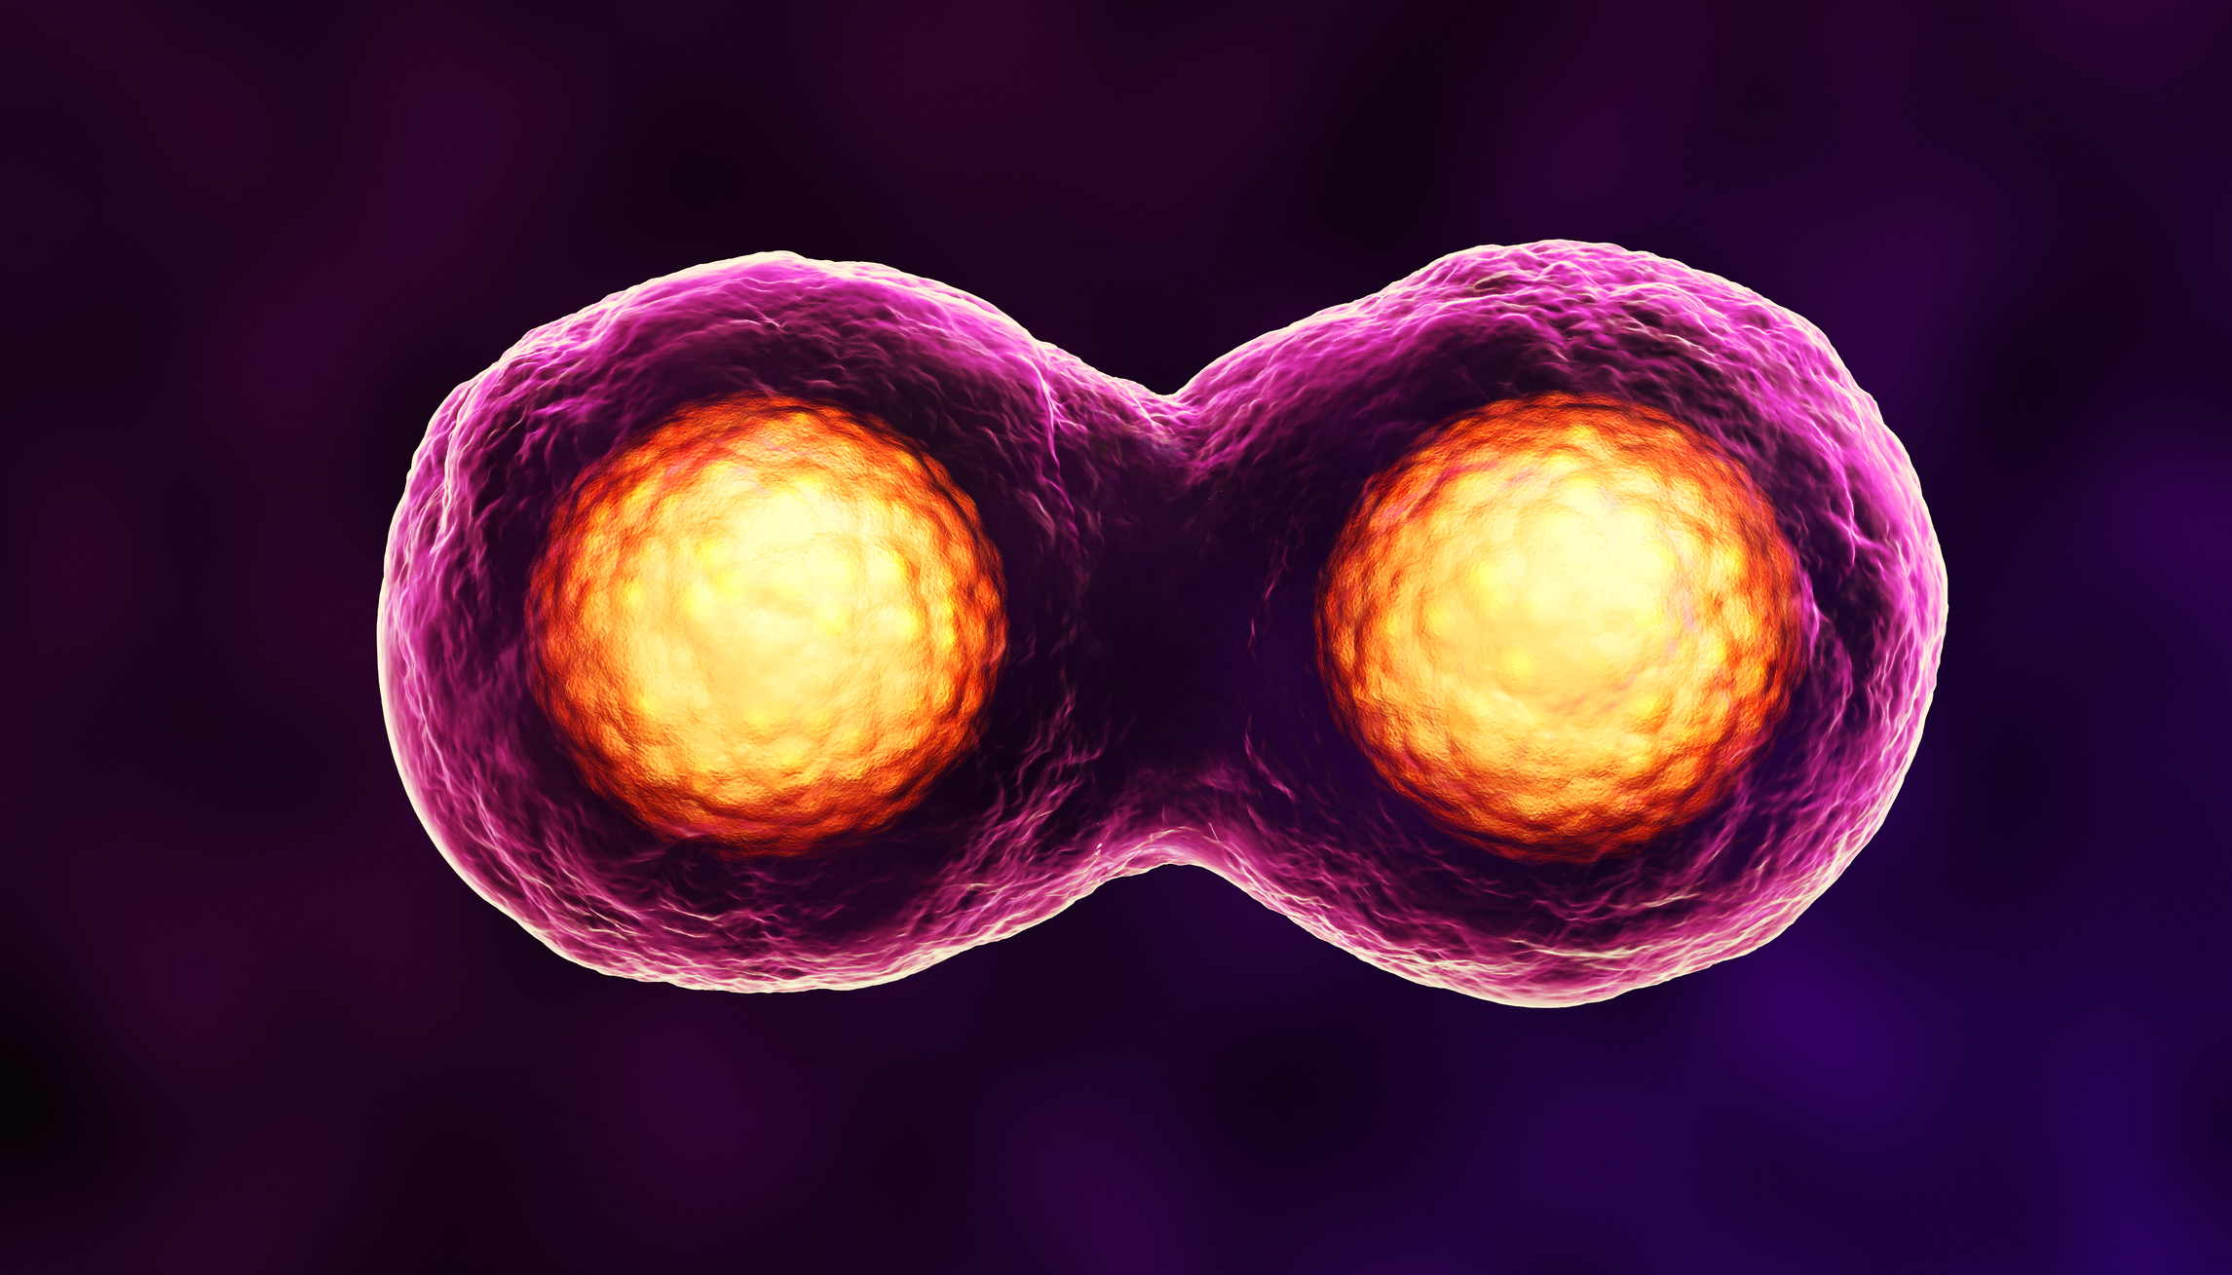
What happens when CDK4 goes wrong?
Next, we validated CDK4 as a relevant target for our overall investigation: is it implicated in cancer and how?
A brief literature review, found in table 1 on the next slides, showed that overexpression of CDK4 is consistently associated with an increase in carcinoma initiation and tumorigenesis, as well as the maintenance of aberrant proliferation
Figure 4: Visual representation of cell cytokinesis. Image take from https://www.biocompare.com/Bench-Tips/351390-Cell-Proliferation-Analysis-by-Flow-Cytometry-Tips-for-Optimizing-Your-Experiment/

Slide 7
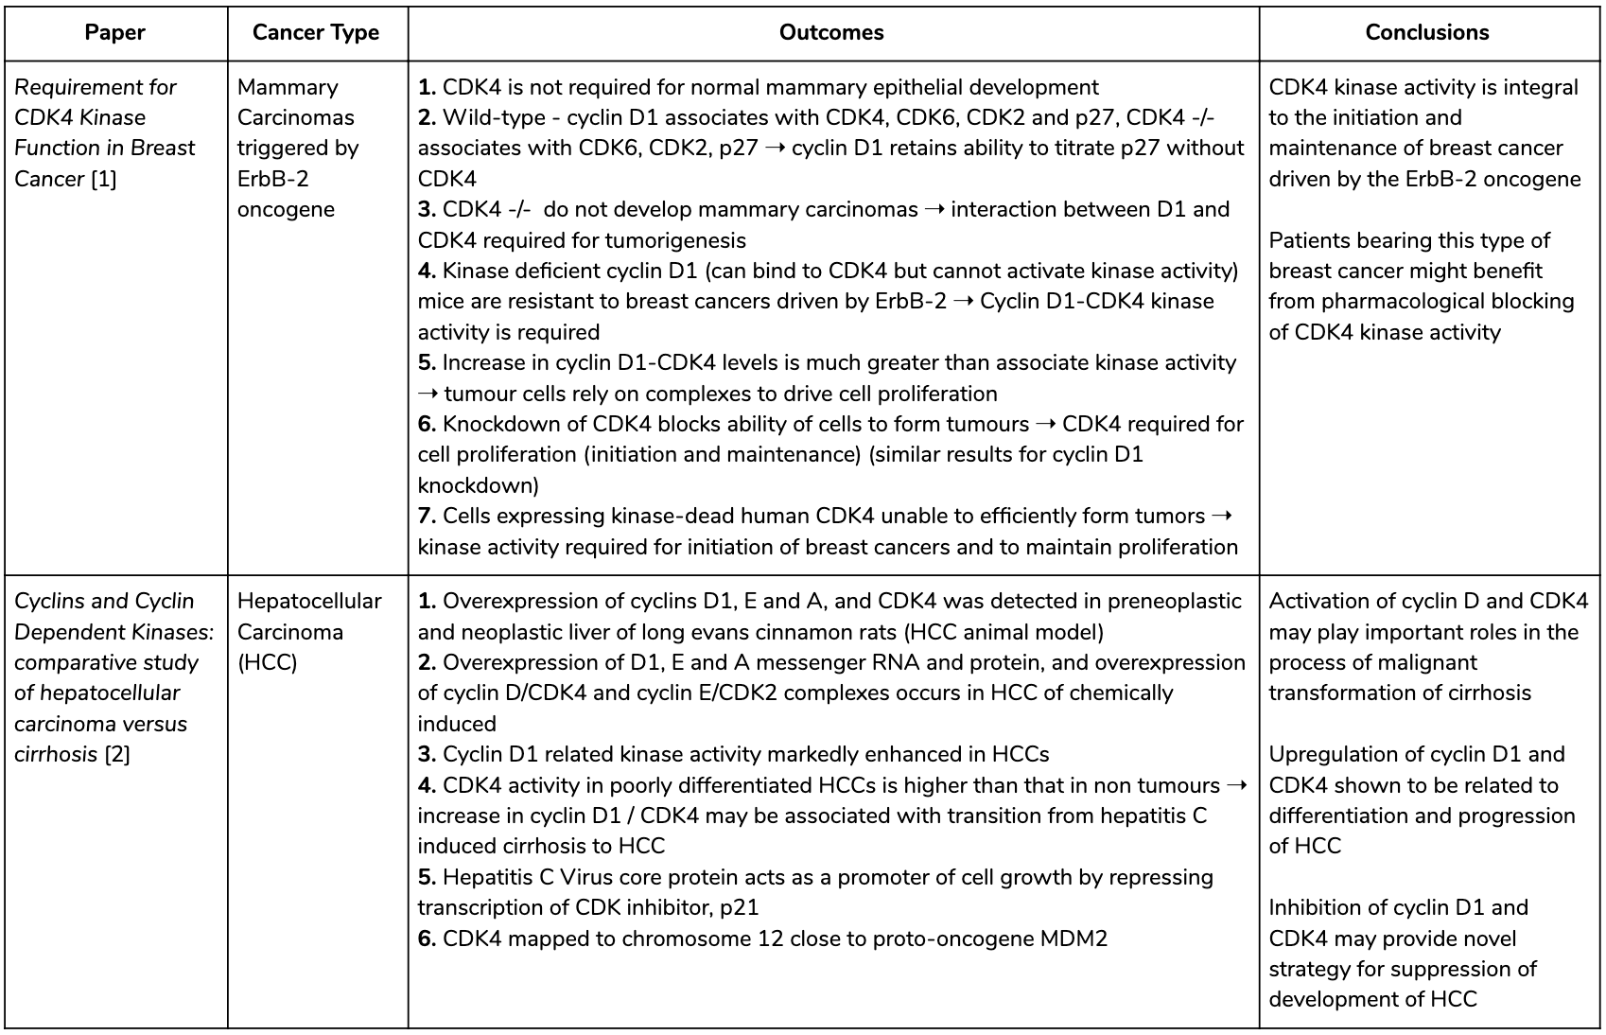
Table 1: Literature Summary of Journal Articles Examining role of CDK4 in various cancers. This table illustrates that CDK4 in implicated in multiple cancers and is therefore a good target for cancer treatment research

Slide 8
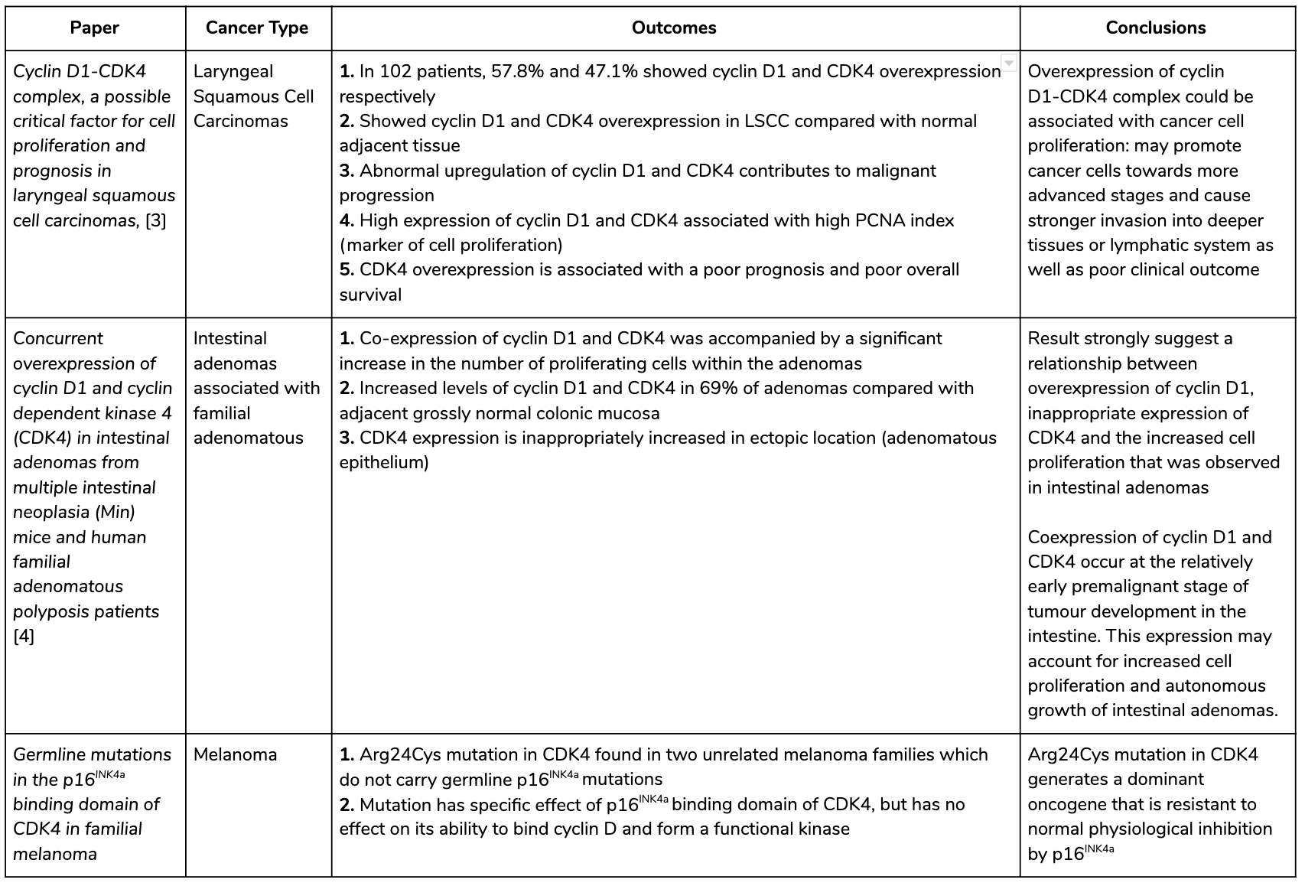
Table 1: Literature Summary of Journal Articles Examining role of CDK4 in various cancers. This table illustrates that CDK4 in implicated in multiple cancers and is therefore a good target for cancer treatment research

Slide 9
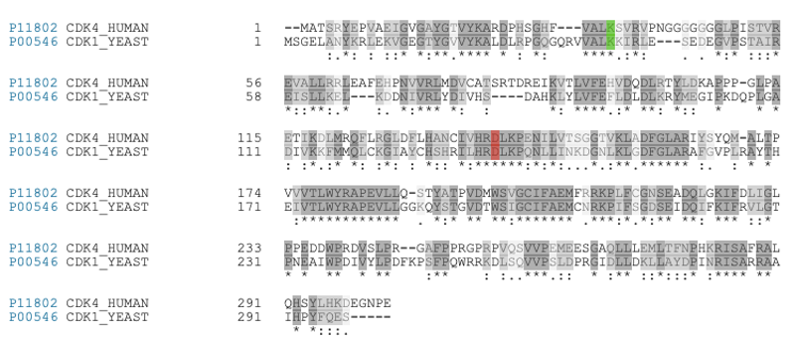
Finding a Yeast Homolog
Figure 5: Sequence alignment of human and saccharomyces cerevisiae CDK4. Sequences and alignment obtained through uniprot.org
With CDK4 resolved as our protein of interest, we next needed to determine a yeast homolog so that we could utilise both experimental assays and network analysis to further our understanding of CDK4’s importance for the cell. Yeastmine.yeastgenome.org was used to find the homolog YBR160W, which is also referred to as CDC28. A sequence alignment done through uniprot.org, shown in figure 3, of human CDK4 and CDC28 revealed high homology, most importantly a similar binding and active site. Sketchfab was also used to assess these differences and compare the homologs (https://skfb.ly/6Wtqn )

Slide 10
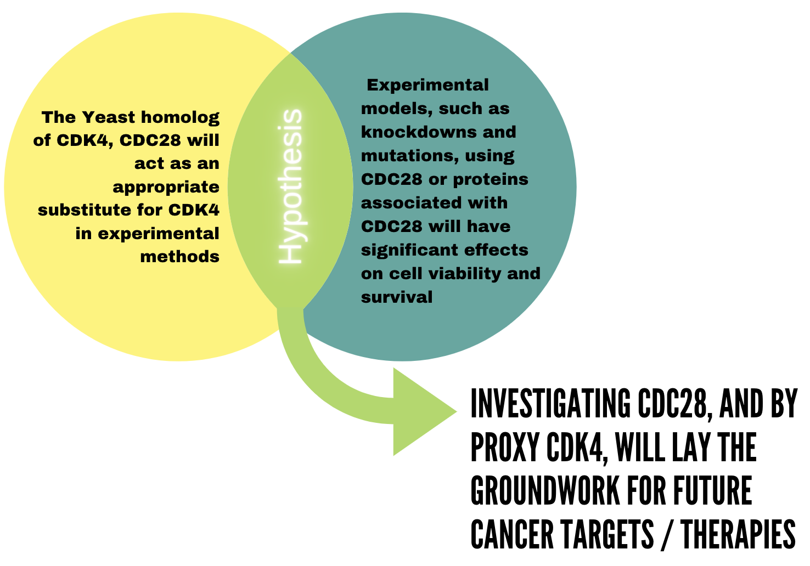
Figure 6: Diagram representation of the project’s overarching hypothesis and aim

Slide 11
Integration of Biochemical and Mathematical Components
Notes:
PUT STRING NETWORK OF CDK4 HERE

Slide 12
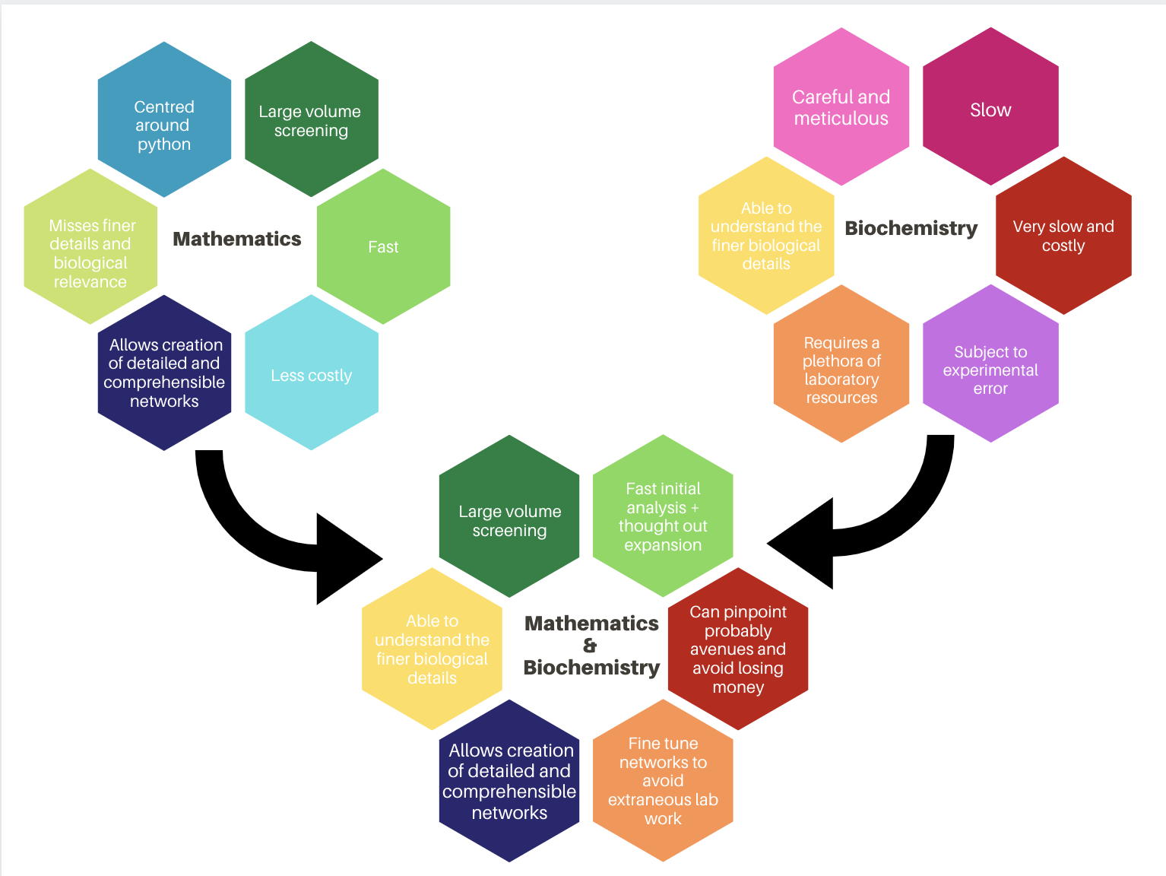
Figure 7: Schematic of integration of two disciplines

Slide 13
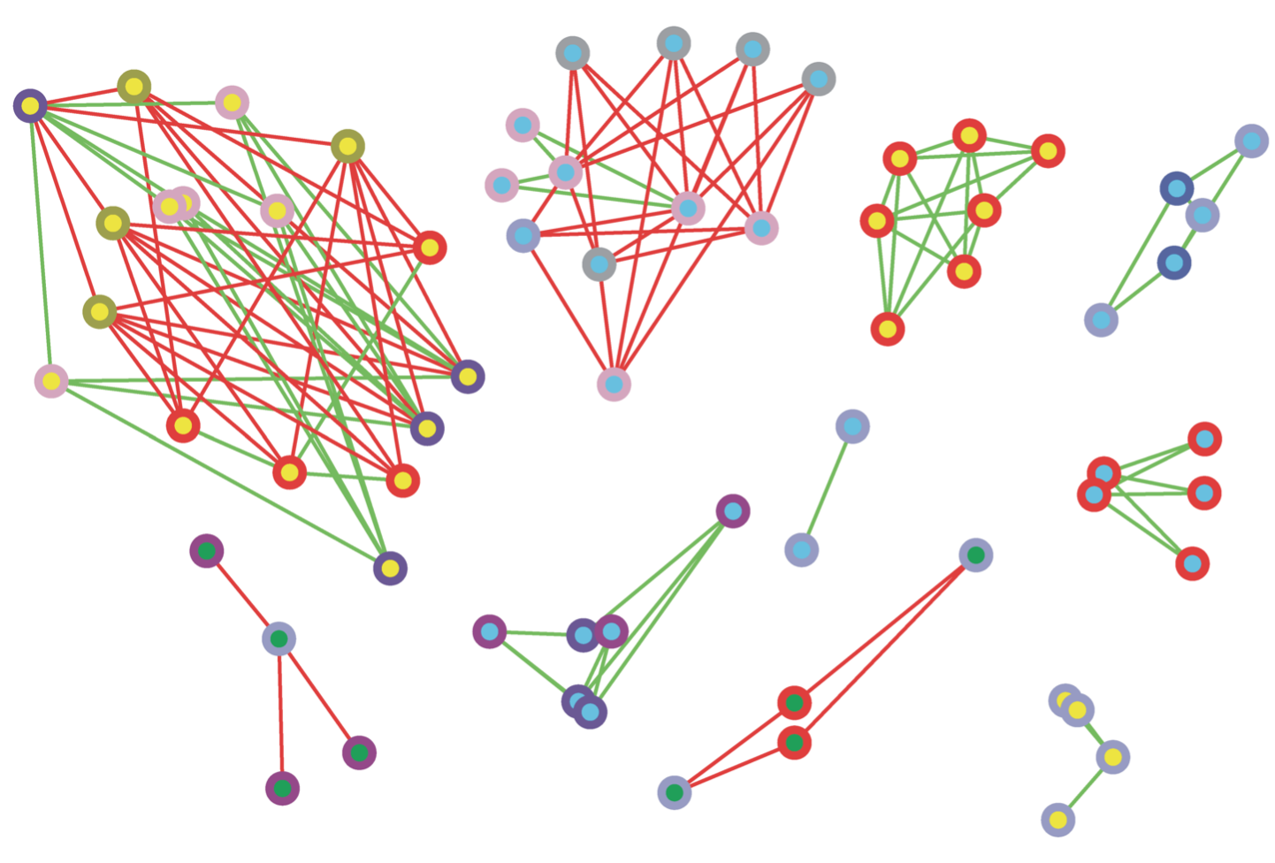
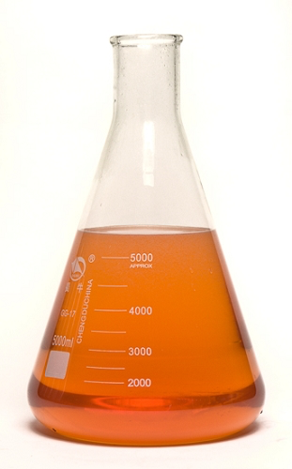
Justification
The integration of biochemistry and mathematics is crucial in an age where scientific discovery cannot possibly keep up with the pace of virus and disease proliferation. In such an era, it is essential to continue to develop and understand new networks between proteins that are continuously mutating in the environment or unknowingly infecting mankind. In these instances, the speed with which mathematical networks, in particular in conjunction with Python provides unsurpassed and unequalled combinatorial power.
However, the discovery of these networks are never biologically sensible nor feasible to successfully become a part of clinical trials. Thus, previous biological network is necessary to understand, and filter through this enormous volume of knowledge – carefully deducing which of these proteins may possibly be experimented upon in a laboratory basis. Although a large number of proteins may be experimented upon, some of these proteins may still have unknown effects upon other proteins which are also essential for human function. In these instances, network analysis can again probe a large network of proteins to understand the wider implications of deleting, mutating or enhancing concentrations of this protein.

Slide 14
Community detection and centrality measures
Notes:
PUT STRING NETWORK OF CDK4 HERE

Slide 15
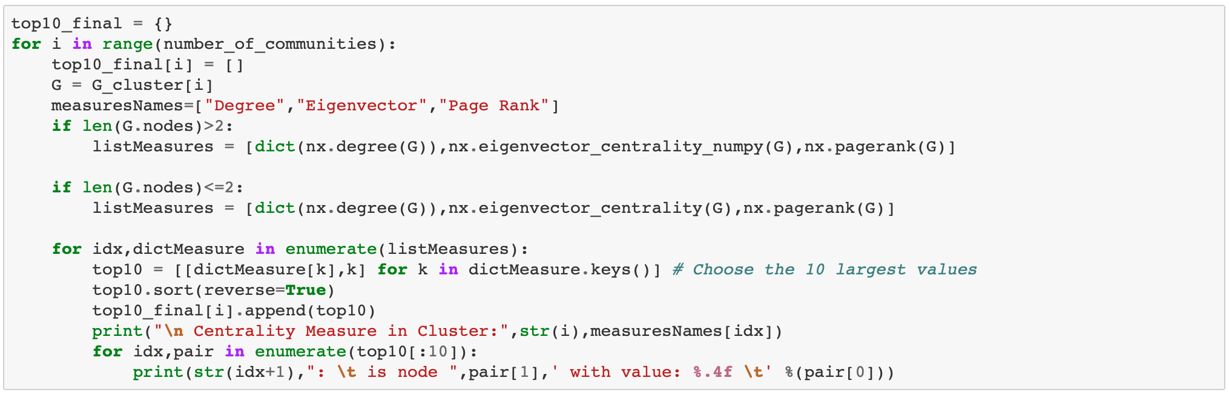
FLOW:
1/ None of the top 30 (by degree) nodes have biological relevance
2/ Remove the top 30 nodes
3/ Find communities relevant to YBR160W
4/ Analyse 28 communities
Ranking by centrality measures
Degree
Eigenvector
Page rank

Slide 16
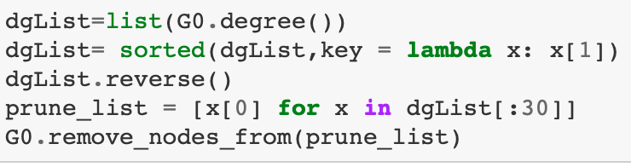
Prune top 30 nodes
1/ Analyse biological relevance of top 10 communities
2/ Some proteins show importance -> possible experimental approaches / uses
YGR232W
YKR089C
CLB1
CDC28

Slide 17
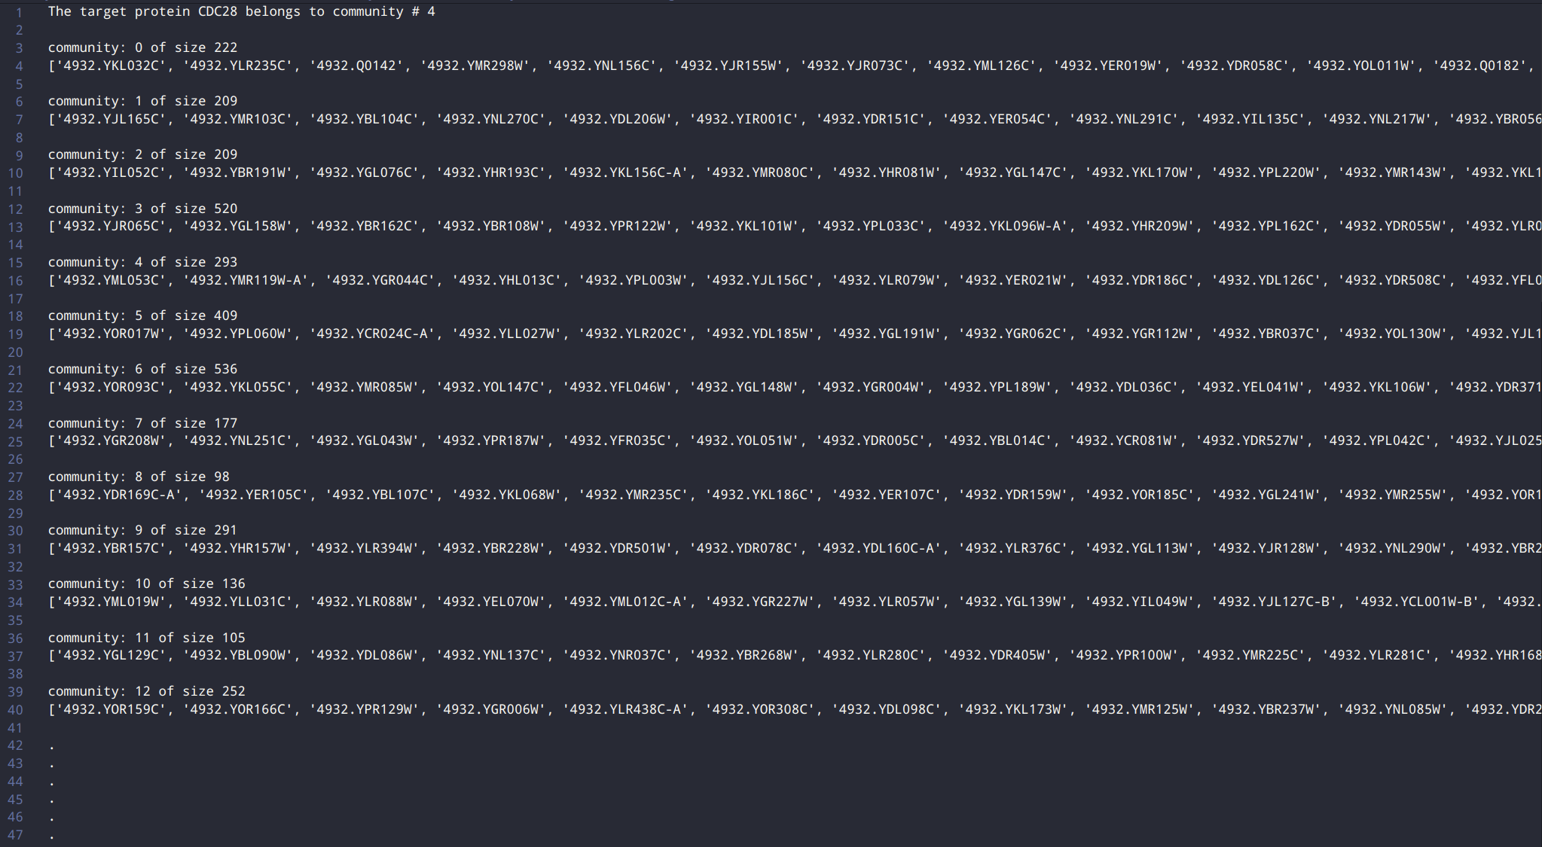
Please find relevant code/results for community detection and a video explanation in Math_community_detection folder.

Slide 18
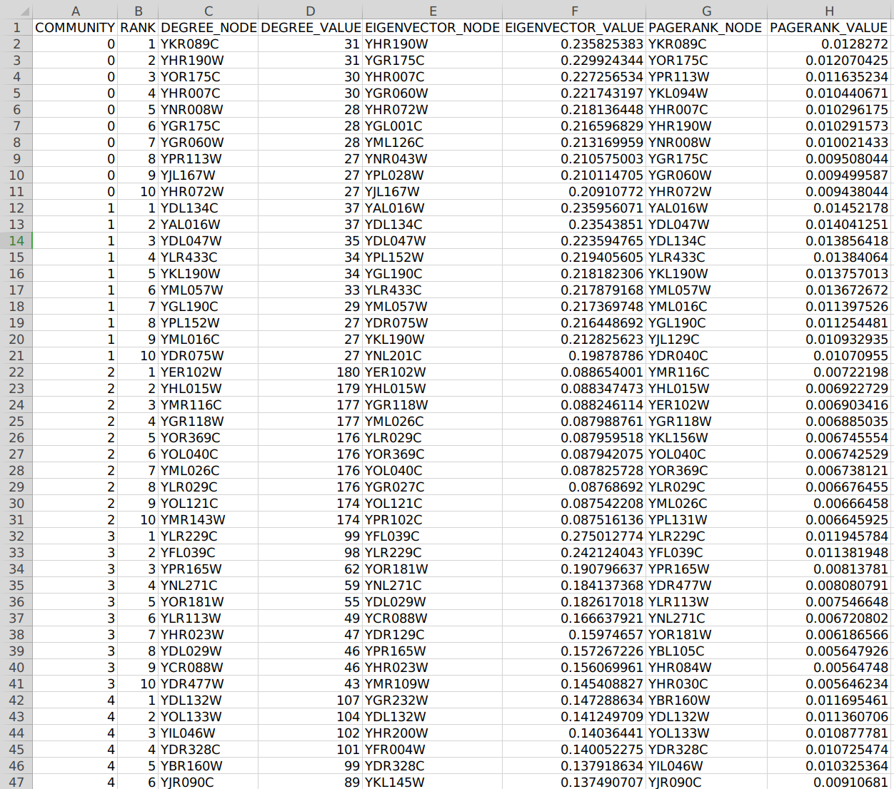
We found “interesting” nodes by centrality measures including degree, eigenvector, page rank centralities for each of the communities, please find relevant code/results and a video explanation in Math_interesting_nodes_by_centrality folder.

Slide 19
Identifying proteins of interest
The list of proteins given to us by the maths students proved very useful. Using their data we were able to identify multiple proteins of interest that could be used experimentally relating to CDC28 in different ways
Our findings are summarized in Table 2; proteins that are in bold are the ones we focused on in the methods below
Notes:
PUT STRING NETWORK OF CDK4 HERE

Slide 20
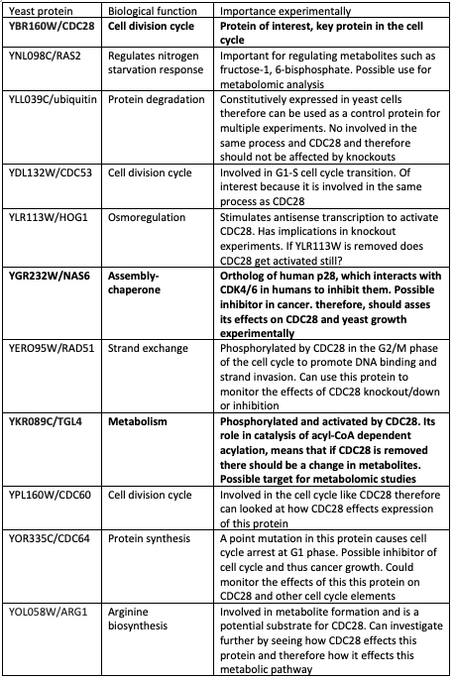
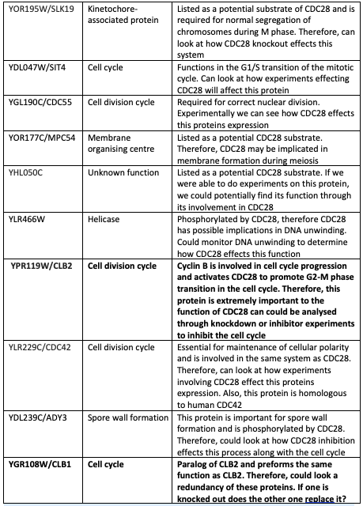
Table 2: Protein analysis of two different lists of communities (one pruned, one unpruned) provided by the math students. These proteins were analysed using Saccharomyces genome database. Looked at top 10 proteins in 28 communities for each list and found 23 proteins “of Interest” based on their relationship to CDC28 and use experimentally

Slide 21
Methods
Notes:
PUT STRING NETWORK OF CDK4 HERE

Slide 22
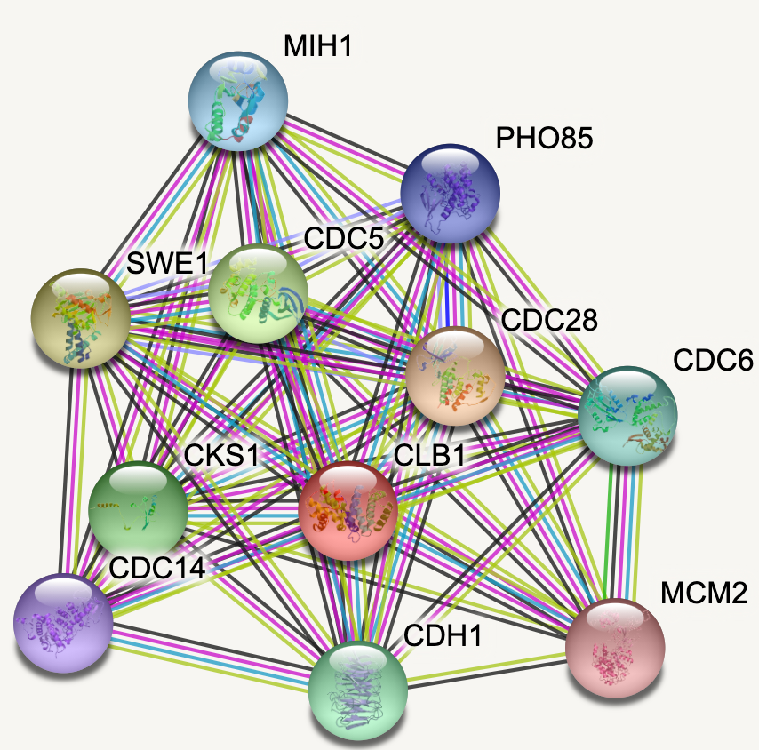
Method 1: YGR232W

Slide 23
Introduction to Method 1
AIM
To test the strength of interaction between CDK4 and YGR232W
BACKGROUND
Deletion of the YGR232W gene should mirror absence of gankyrin as it is an orthology. Gankyrin is an oncoprotein, but any interaction must be mediated by S6. Gankyrin also interacts with CDK4 in humans to inhibit it.
METHOD OVERVIEW
Y2H: Check interaction between S6 constructs and gankyrin
Deletion of YGR232W - to see effect and interaction with CDK4
Western Blot - to see interaction between CDC28 and gankyrin

Slide 24
Controls
Materials:
Yeast strain HF7C
S6 deletions
S6Δ5, S6Δ6, S6Δ7, S6Δ8, S6Δ9
Gankyrin
GAL4 activating clone, p71Int2
Medium lacking tryptophan, leucine and histidine
Negative Controls:
Medium lacking tryptophan, leucine and histidine
Total Replicates
There will be 3 replicates of each

Slide 25
1/ Y2H
S6 deletions to produce different cDNAs.
Each cDNA gel purified and cloned into plasmids
Each cDNA excised at restriction sites using endonucleases
Ligate into the corresponding sites of the vectors pGBT9 and pAS2–1
Each construct also inoculated into medium lacking amino acids leucine, tryptophan and histidine
Each construct co-transformed with gankyrin GAL4 activating clone, being p73Int2, into yeast strain HF7C
Confirm ALL constructs by DNA sequencing
After 3 days, each of the co-transformed constructs streaked onto medium lacking amino acids leucine, tryptophan and histidine to compare interaction between constructs and gankyrin
Comparison of medium lacking and not lacking the amino acids allows confirmation of growth

Slide 26
2/ Deletion of YGR232W
Excise according to restriction enzymes
Amplify this cDNA section using PCR to confirm presence
Clone this into plasmid pGANKN5N3

Slide 27
3/ Western Blot
Construct from (2) transformed with gankyrin-expressing GAL4-activating clone, p73Int2, into yeast strain HF7c.
Add lysis buffer then remove insoluble components by centrifugation
Lysate incubated with Anti-CDC28 antibody and mechanically agitated at 4C
Allows visualisation of gankyrin and determines the interaction with CDC28
Immune complexes have SDS loading buffer added
Precipitated immune complexes washed with lysis buffer and excess buffer removed via centrifugation

Slide 28
Method 2: YKR089C

Slide 29
Introduction to Method 2
AIM
To see the effect of caloric restriction on yeast growth, analysed through metabolomics
BACKGROUND
Media deficient yeast leads to changes in growth patterns, allowing us to facilitate or suppress yeast growth. YKR089C is interchangeable with TGL4, both expressed within the yeast strain S288c.
METHOD OVERVIEW
Starvation of yeast by suppressing different nutrients
Analysis through NMR or Mass Spectrometry

Slide 30
Controls
Materials:
Yeast strain BY4742
Plates with media deficient in L-histidine, L-leucine, L-methionine and L-uracil.
Negative Controls:
NMR measurement taken at time = 0
Total Replicates
There will be 3 replicates of each
Creation of yeast in media with strain BY4742, a deletion strain derived from S288c, which expresses the gene TGL4, interchangeable with YKR089C. BY4742 lacks particular growth factors: HIS3, LEU2, MET15 and URA3; all placed in medium deficient in L-Histidine, L-Leucine, L-Methionine and L-Uracil respectively to allow observation of growth patterns.

Slide 31
Starvation of yeast strain S288c
Streak BY4742 onto separate plates with media deficient in L-histidine, L-leucine, L-methionine and L-uracil.
Inoculate media and measure OD600 (t=0h)
Analyze metabolites via NMR at different spaced time points : 0, 6, 12, 18, 24 hours
Draw conclusions about how growth is affected by inhibition particular growth factors, i.e. particular amino acids
Graphically present OD600 / OD600 (start) to understand changes in growth rate

Slide 32
Method 3: CLB1

Slide 33
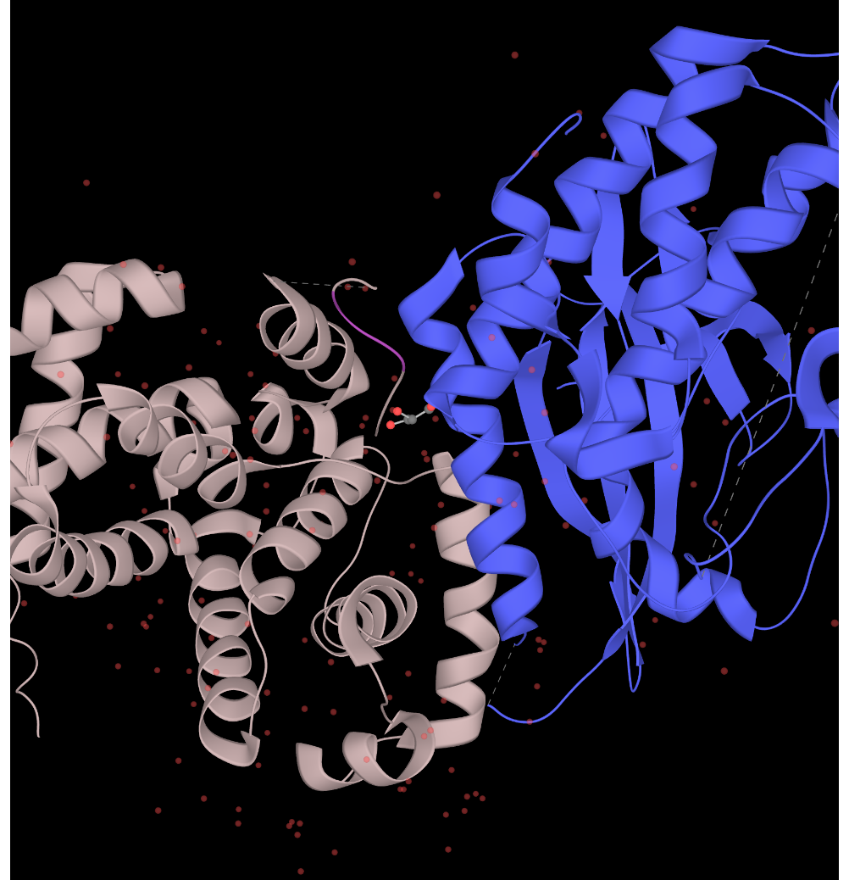
CLB1 Mutation + Binding Site
Beta strand has:
Exposed binding
Same residues at start and end between yeast and human protein [structural homology]
Potential for inhibitor binding
Perhaps phosphorylation of it can have an effect on its role in the cell cycle.

Slide 34
Introduction to Method 3
AIM
To understand whether phosphorylation of CLB1 has effects on nuclear localisation which may affect entry to Meiosis I
BACKGROUND
CLB1 has previously been shown to have modifications and localisation alterations during Meiosis I
METHOD OVERVIEW
Y2H
Immunoprecipitation
Kinase Assay

Slide 35
Controls
Materials:
Primary antibody = Mouse anti-myc Roche
Lambda protein phosphatase (NEB)
Phosphatase inhibitor (1 mM NaVnO4, 50 mM NaF, 5 mM EDTA and 0.1 µM Okadaic acid)
Kinase assay buffer (50 mM Tris/HCL pH7.5, 10 mM MgCl2, 1 mM DTT and 5 mM β-glycerophosphate)
Positive Controls:
No addition of phosphatase OR phosphatase inhibitor
Negative Controls
Addition of phosphatase + phosphatase inhibitor
Total Replicates
There will be 3 replicates of each

Slide 36
Preparation of samples
CLB1 samples grown in yeast to OD600 = 0.8
Samples mixed with lysis buffer then centrifuged to clear the lysate
Lysate mixed with primary antibody
This mixture was incubated at 4C for 1 hour
The mixture was combined with Protein G beads then incubated at 4C for a further 2 hours

Slide 37
Immunoprecipitation
Beads combined with CLB1 was split into three samples
Resuspend in Buffer with lambda phosphatase
Sample 1: add Lambda Protein Phosphatase
Sample 2: add Lambda Protein Phosphatase + phosphatase inhibitors
Sample 3: negative control
Loading SDS buffer added to all samples and heated for 5 minutes
All samples incubated at 30C for 30 minutes

Slide 38
Kinase Assays
Beads combined with CLB1 ( sample 1: phosphatase present, sample 2: phosphatase absent) was washed and suspended in kinase assay buffer
Combine assay with 50 µM ATP + DMSO at 30C
Take samples at 0, 10, 20 and 40 minutes
Compare results from different time points to understand kinetics OVER TIME
SDS loading buffer added to all samples and heated for 5 minutes

Slide 39
NMR
Immunoprecipitation of CLB1 leads to a pure protein sample
Vortex samples with and without lambda phosphatase to extract metabolites
Samples made up for NMR
Assess differences in metabolite concentration

Slide 40
Method 4: CDC28

Slide 41
Introduction to Method 4
AIM
To successfully create a knockdown yeast strain for CDC28 using SiRNA transfection and to assess the effects of this knockdown on yeast apoptosis and metabolism.
BACKGROUND
CDC28 is a crucial protein involved in the yeast cell cycle, therefore removal of this protein should have interesting effects on cells, which may have implications in cancer therapies
METHOD OVERVIEW
Creating CDC28 knockdown in yeast
Assessing yeast cell viability using Metabolomics
Flow cytometry to measure cell death

Slide 42
Controls
Materials:
custom SiRNA oligonucleotides specific for CDC28
Non-targeting SiRNA oligonucleotides
siRNA oligonucleotide for Ubiquitin
AH109 yeast strain
Amaxa Nucleofector Kit V
Nucleofector device
Negative Controls:
-Negative control are cells treated with Non-targeting SiRNA oligonucleotides
Positive Controls
-Positive control are cells treated with siRNA oligonucleotide for Ubiquitin,
Total Replicates
There will be 3 replicates of each

Slide 43
Knockdown method
Source Custom SiRNA oligonucleotides from thermofisher (ready to use)
Inoculate AH109 yeast cells in YPD
Allow cells to grow, remove media and wash cells
Follow protocol provided regarding the use of Nucleofector device to transfer the SiRNA into the yeast cells
confirm effectiveness of CDC Knock-down using qPCR and western blot method
Repeat steps with the different controls mentioned in previous slide
Incubate cells to allow process to take place

Slide 44
Assessing the effects CDC28 knockdown on yeast cell metabolomics
Prepare AH109 Yeast stock and streak onto plate
Inoculate from a colony into a YPD culture and grow to saturation
Add ice cold ethanol to dissolve metabolites
Vortex yeast cells in the presence of glass beads to extract metabolites
Repeat for CDC28 knockdown yeast to assess the difference in yeast metabolites
Record and analyse NMR spectra of each sample
Purify sample and remove non-metabolites

Slide 45
Assessing the effects of CDC28 on apoptosis using flow cytometry
Inoculate from a colony into a YPD culture and grow to saturation
The cells grown in normal YPD growth media is the control
Prepare AH109 Yeast stock and streak onto plate
Remove cells from media and wash them. Then resuspend cells
Use flow cytometry to measure cells in early or late apoptosis
Stain cells with PE-annexin V and 7-AAD to detect early and late apoptosis
Repeat for CDC28 knockdown yeast

Slide 46
YGR232W is a paralog of gankyrin which is supposed to inhibit CDK4 in humans. Therefore we expect YGR232W to act in a similar way to gankyrin when interacting with CDK4 in yeast models
Under starvation restrictions such as being grown in amino acid deficient media, yeast cells will present abnormal growth patterns and a change in their metabolites
Experimental predictions
In the absence of CDC28 the cell cycle should be halted. If this occurs apoptosis should follow as the cells will not grow, lose viability (metabolomics) and will therefore die.
Inhibiting CLB1 will stop CDC28 binding and will therefore halt or slow the cell cycle. Therefore we will see apoptosis and a change in cell viability through metabolomic studies
Figure 8: Hypothesised results for designed methodologies

Slide 47
Path Analysis
Notes:
PUT STRING NETWORK OF CDK4 HERE

Slide 48
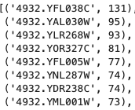
Path Analysis
We computed all the shortest paths between the yeast homolog of CDC28 (YBR160W) and one node of interest (YLR466W):
The aim here was to find meaningful paths between our target node and an interesting node which contains a biologically significant node.
Along all 8 of the shortest paths, the node YFL038C has degree 150, and within its own community, YFL038C has a degree of 131, making it the largest connected node in its community.
We then found all of the next shortest paths between YBR160W and YLR466W after removing YFL038C. We found that there were 22 new shortest paths of length 4.
Please find the code/results in the Math_path_analysis_between_YBR160W_and_YLR466W folder
The number of connections this node has within this community

Slide 49
Path Analysis
Determining the threshold for shortest paths (or more accurately paths of length less than or equal to a given k) was done experimentally so as to produce graphs containing more than a few trivial paths
The process for determining said value of k can be automated if a criteria for acceptance is agreed upon in advance with minimal increase in computation.
Though proof (and a more precise statement) is provided, we verified with our own calculations that the process was in fact only marginally slower than finding all of the paths for k given in advance.

Slide 50
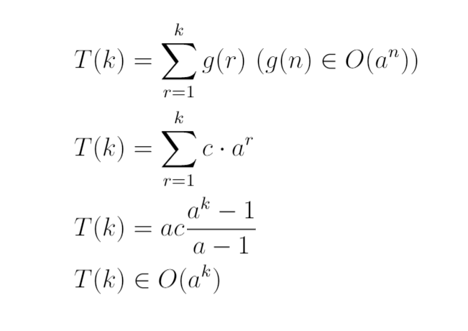
Path Analysis
The search for paths of length less than k is exponential in k.
Hence, the cost of computing redundant shortest paths until an appropriate k is found forms a geometric series
The complexity remains (asymptotically) unchanged.

Slide 51
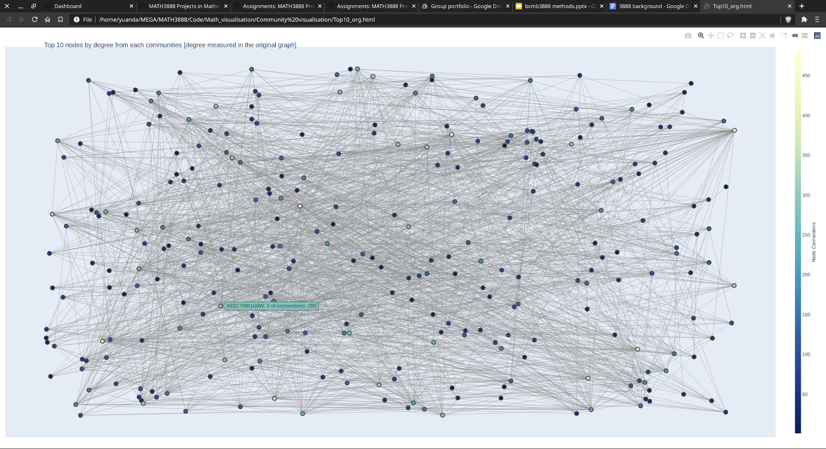
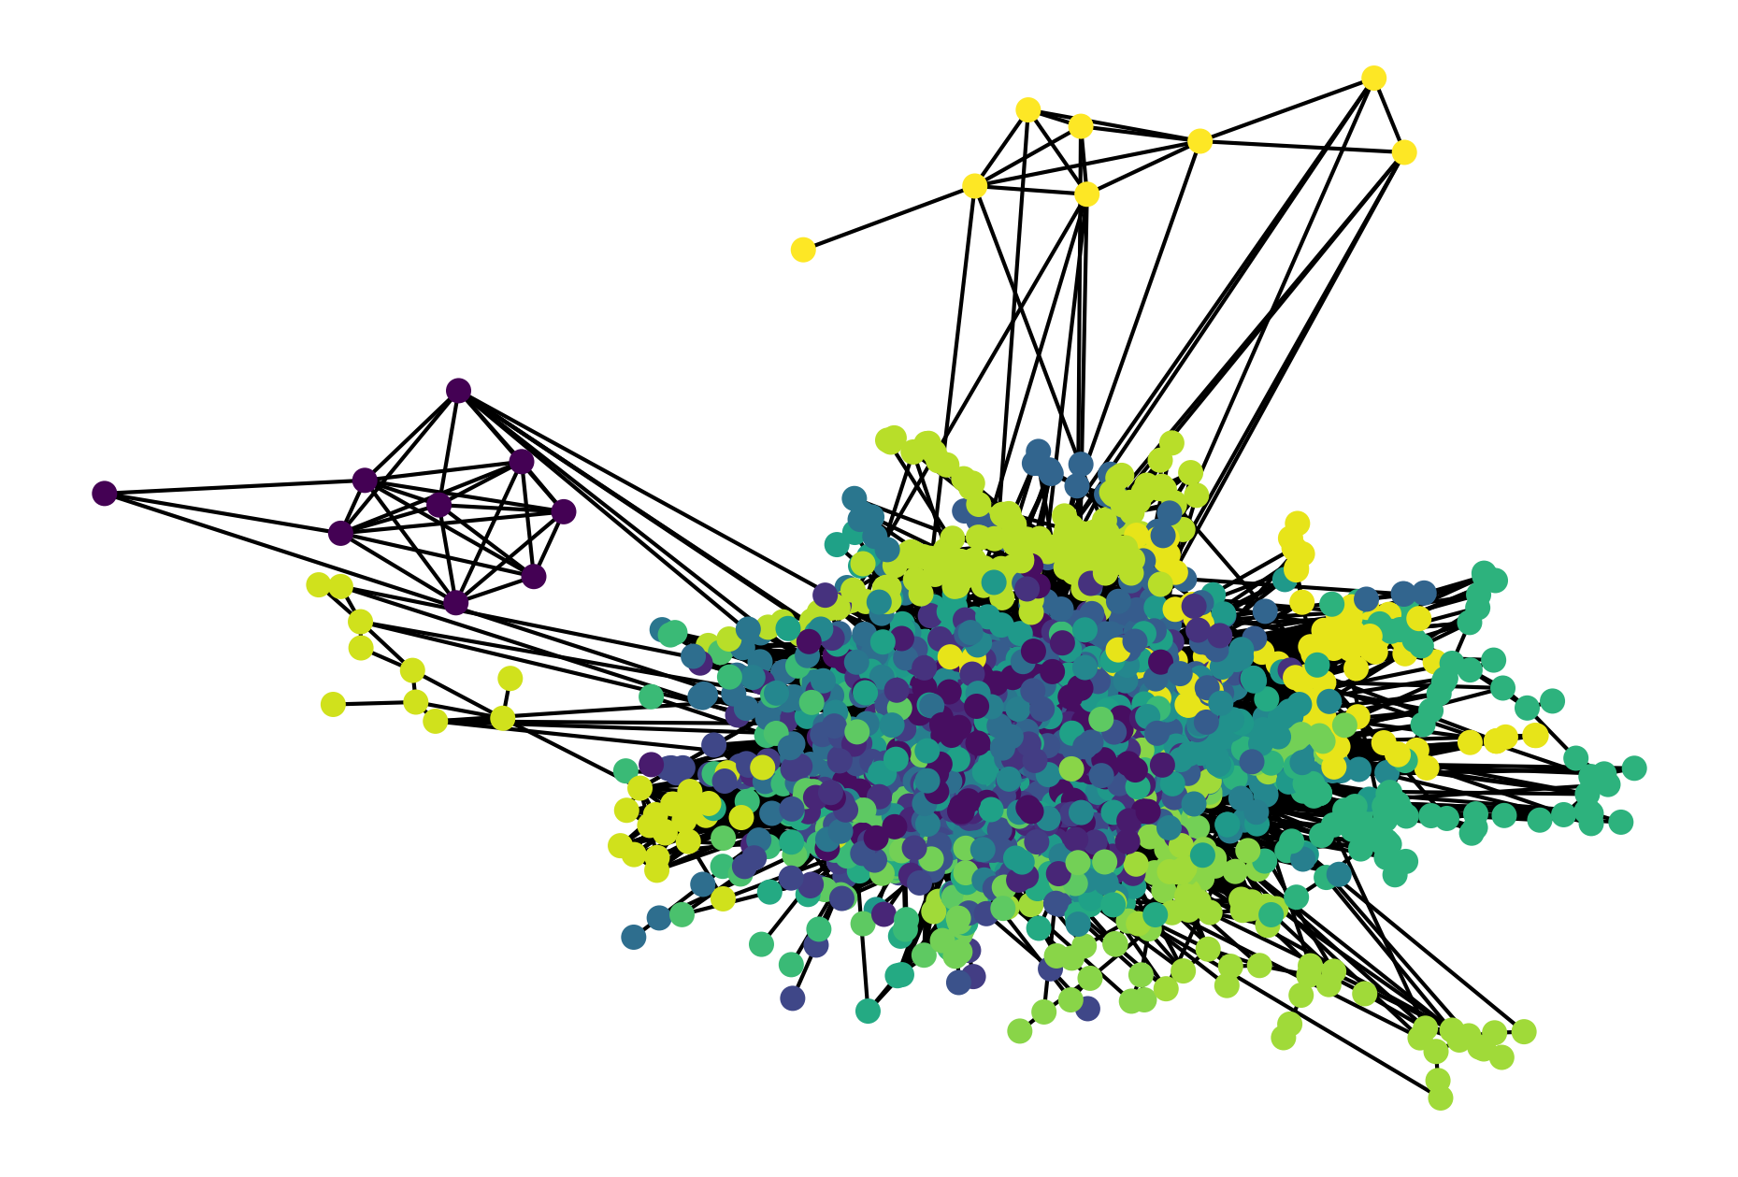
Maths extra methods - Community visualisation
community structure diagrams (colour represents different communities)
We made interactive community graph diagrams, (colour gradient represents the degree)
Please find the code/results and a video explanation in Math_visualisation folder

Slide 52
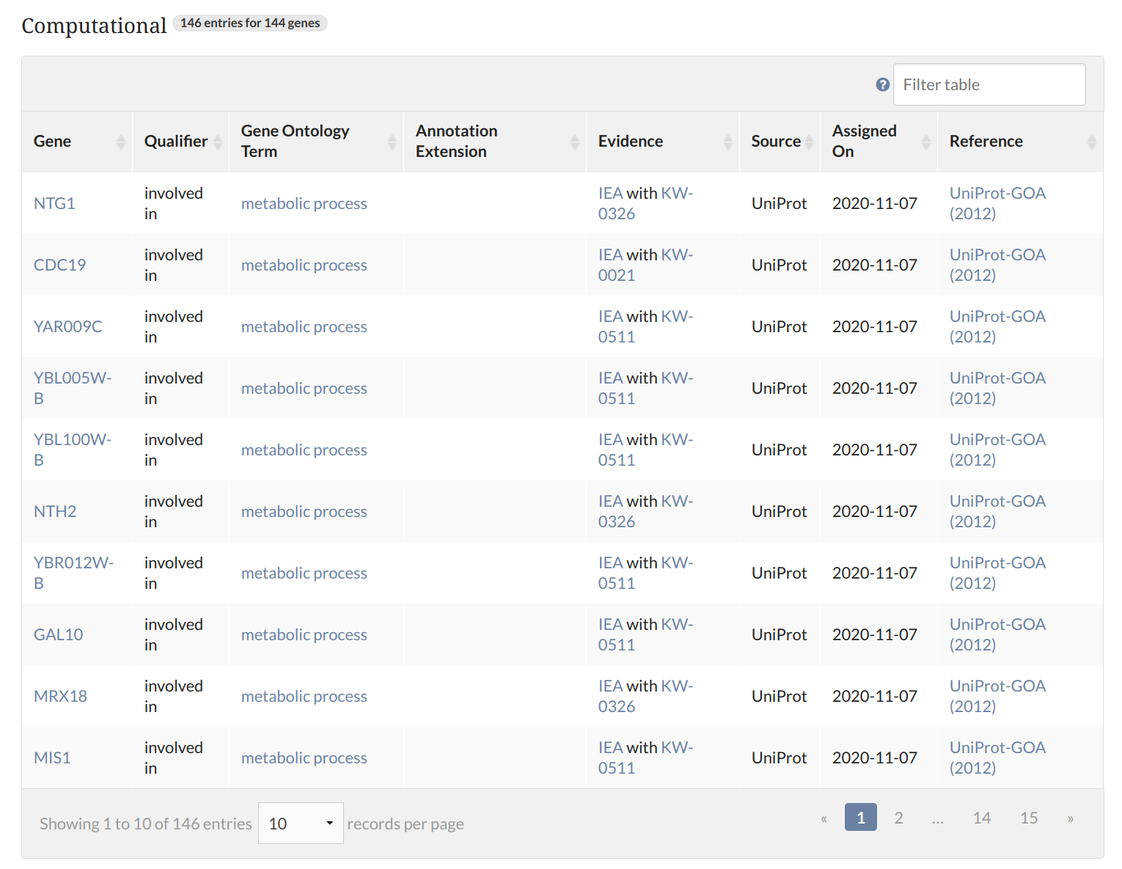
Maths extra methods - Finding potential nodes for metabolomic studies
Please find the code/results and a video explanation in Math_finding_protein_for_metabolomics folder.
Saccharomyces Genome Database

Slide 53
Biochemistry concluding remarks
With the aid of the maths students we have been able to discover interesting proteins that may be associated with CDC28 and therefore design experiments based on these discoveries
This has enabled us to not only design experiments that focus on CDC28 as a replacement for CDK4 but also allowed us to design other experiments that target proteins connected to CDC28
This in turn allows us to think about how we may be able to develop cancer therapies while making use of these protein interactions

Slide 54
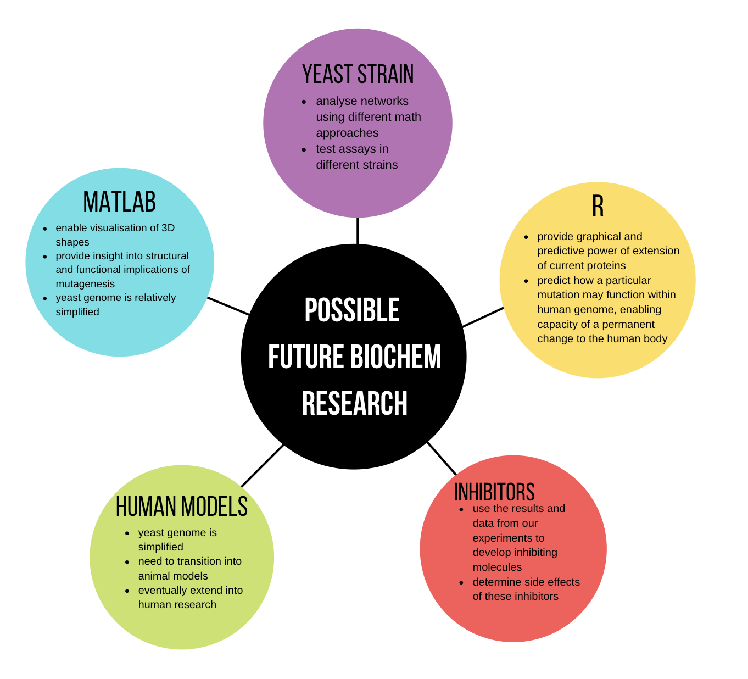
Figure 9: Schematic of future biochemical research

Slide 55
Further Mathematical Research
Many communities and proteins were identified as being potentially of interest by the BCMB students
Methods of processing collections of large data sets (individually and in aggregate) becomes necessary
Some of the sets of nodes identified by the BCMB students;
{YGR232W, YOR335C ,YOL058W, YHL050C YLR466W}
{YNL098C, YLL039C, YDL132W, YER095W, YPL160W, YDL047W, YGL190C, YOR117C}
{YKR089C, YLR113W, YHL050C}

Slide 56
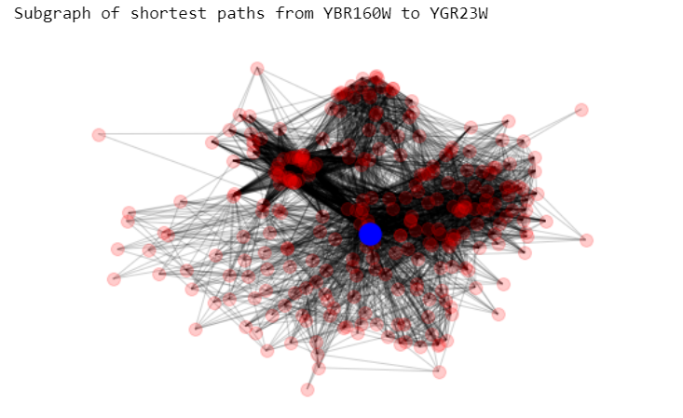
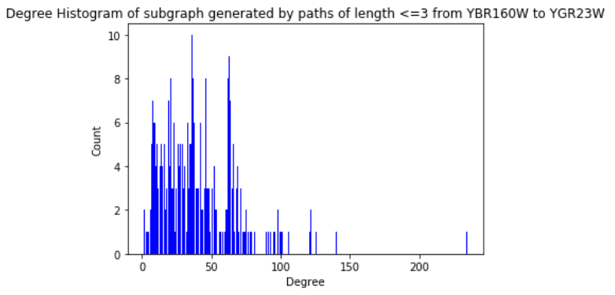
Further Mathematical Research
For each node in each of these sets, our path analysis techniques generate subgraphs the sizes of which make simple human analysis difficult.

Slide 57
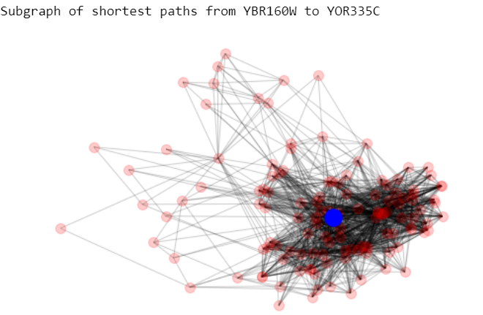
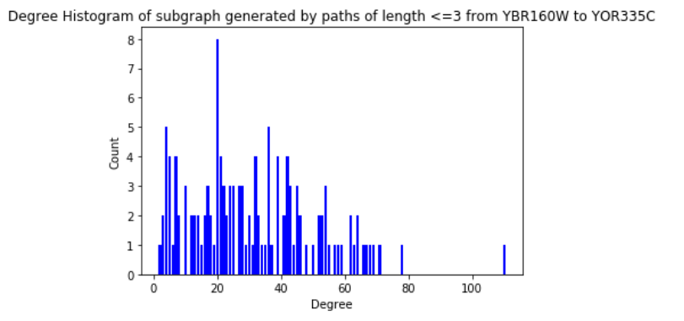
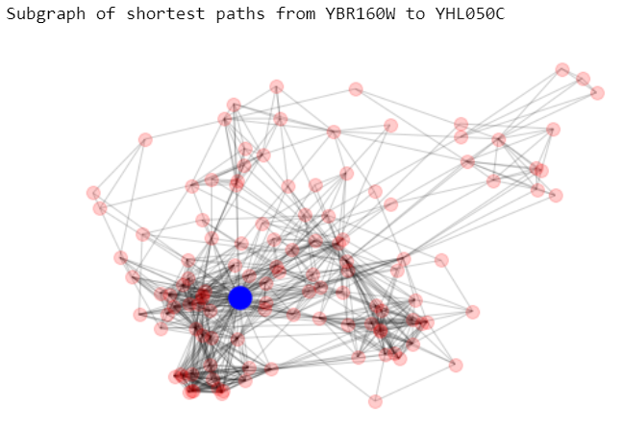
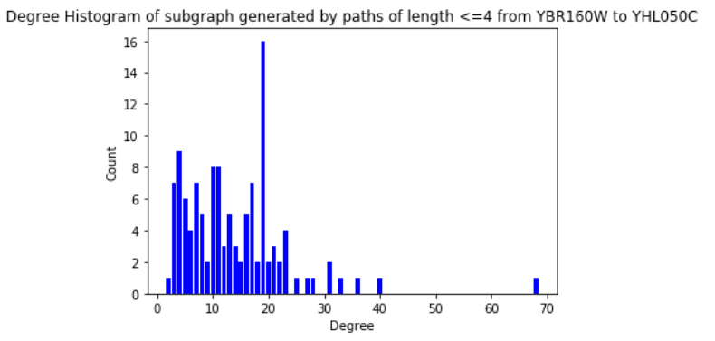
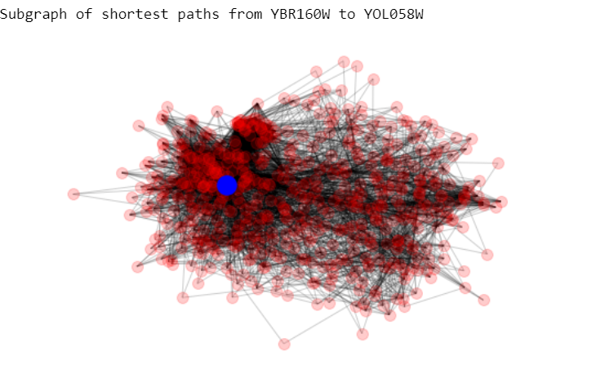
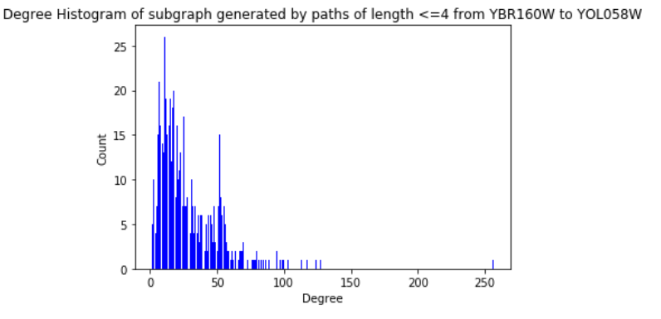
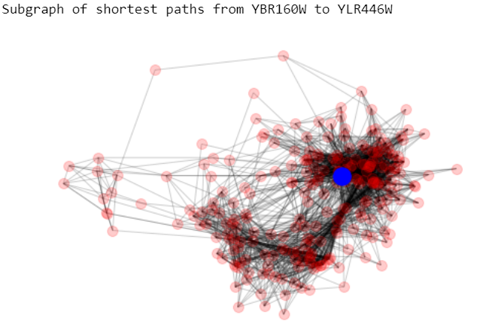
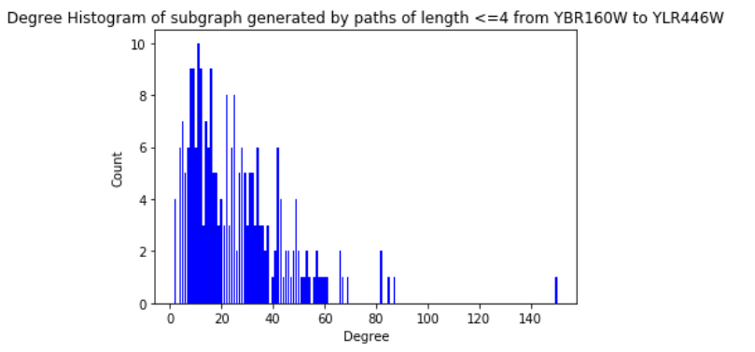
Further Mathematical Research
Moreover the wealth of data available and the ease of computation creates a data glut.

Slide 58
Further Mathematical Research
Simple analysis of these graphs with the common centrality measures (for example simply degree) further exacerbates the problem by generating a longer list of candidates for study.
Should they exist, we would prefer to identify proteins which foster communication between the yeast homolog and many of the proteins known to be connected to it.
If such nodes exist in the network we might expect that they are present in many or every k-path subgraph.
Hence, we decided to study the intersection of these graphs

Slide 59
Further Mathematical Research
Advantages:
This method is guaranteed to find nodes involved in the communication between YBR160W and every established node of interest
It produces smaller graphs which are less strongly connected and more amenable to human analysis
It dramatically reduces the input size for computationally expensive methods and the search space for candidate proteins while preserving broadly important nodes

Slide 60
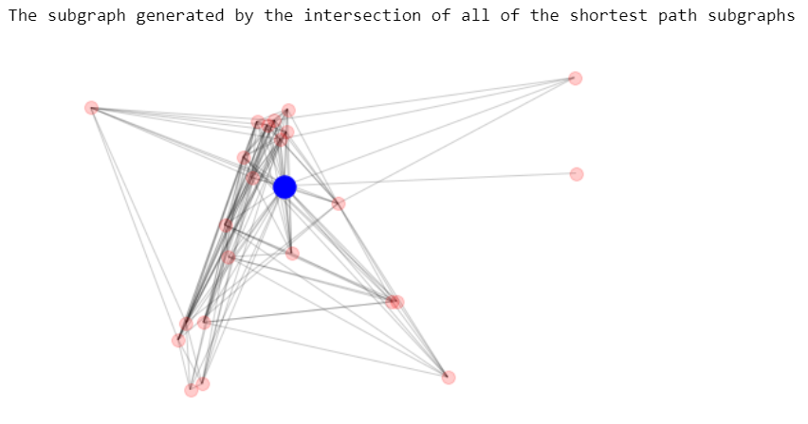
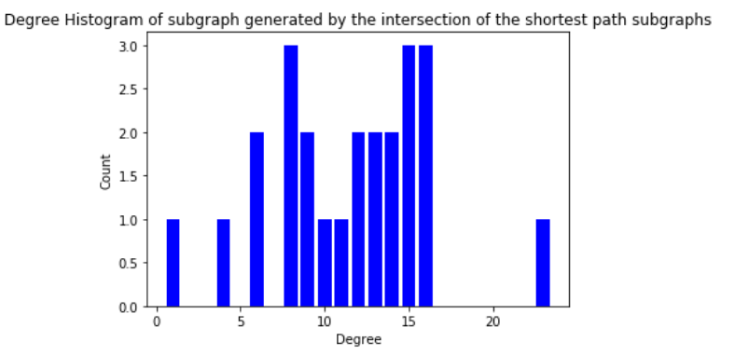
Further Mathematical Research
None of the shortest path subgraphs produced cut vertices or cut edges
The intersection has a cut edge, YBR160W - YKL048C
This protein (YKL048C didn’t appear as a highly connected node in any of the shortest path subgraphs.
Proteins with similar qualities may be invisible to analysis of narrower scope

Slide 61
Further Mathematical Research
Drawbacks
If input sets of nodes are too large or unrelated the intersection may be too sparse or not particularly relevant
Nodes present in a strong majority of but not all of the nodes will not appear in the intersection but may be relevant
Fortunately these drawbacks only punish careless selections of nodes and agglomerations of networks
Sets of nodes to be evaluated should be chosen judiciously
The intersection procedure can be made more nuanced to include proteins which appear in at least a certain proportion of the input subgraphs rather than all of them

Slide 62
References
Yu Q, Sicinska E, Geng Y, Ahnström M, Zagozdzon A, Kong Y et al. Requirement for CDK4 kinase function in breast cancer. Cancer Cell. 2006;9(1):23-32.
Masaki T. Cyclins and cyclin-dependent kinases: Comparative study of hepatocellular carcinoma versus cirrhosis. Hepatology. 2003;37(3):534-543.
Dong Y, Sui L, Sugimoto K, Tai Y, Tokuda M. Cyclin D1-CDK4 complex, a possible critical factor for cell proliferation and prognosis in laryngeal squamous cell carcinomas. International Journal of Cancer. 2001;95(4):209-215.
Zhang T, Nanney LB, Luongo C, Lamps L, Heppner KJ, DuBois RN, Beauchamp RD. Concurrent overexpression of cyclin D1 and cyclin-dependent kinase 4 (Cdk4) in intestinal adenomas from multiple intestinal neoplasia (Min) mice and human familial adenomatous polyposis patients. Cancer Res. 1997 Jan 1;57(1):169-75. PMID: 8988060.
Puig-Castellví, F. et al.1H NMR metabolomic study of auxotrophic starvation in yeast using Multivariate Curve Resolution-Alternating Least Squares for Pathway Analysis. Sci. Rep. 6, 30982; doi: 10.1038/srep30982 (2016).
Frederick R. Cross, Matthew D. Jacobson, Mol Cell Biol. 2000 Jul; 20(13): 4782–4790. doi: 10.1128/mcb.20.13.4782-4790.2000 PMCID: PMC85916
Dawson, S., Apcher, S., Mee, M., Higashitsuji, H., Gankyrin Is an Ankyrin-repeat Oncoprotein That Interacts with CDK4 Kinase and the S6 ATPase of the 26 S Proteasome The Journal of Biological Research. 2002; 277 (10893-10902) doi: 10.1074/jbc.M107313200
Tibbles KL, Sarkar S, Novak B, Arumugam P (2013) CDK-Dependent Nuclear Localization of B-Cyclin Clb1 Promotes FEAR Activation during Meiosis I in Budding Yeast. PLoS ONE 8(11): e79001. https://doi.org/10.1371/journal.pone.0079001
Day P, Cleasby A, Tickle I, O'Reilly M, Coyle J, Holding F et al. Crystal structure of human CDK4 in complex with a D-type cyclin. Proceedings of the National Academy of Sciences. 2009;106(11):4166-4170.
Baker S, Reddy E. CDK4: A Key Player in the Cell Cycle, Development, and Cancer. Genes & Cancer. 2012;3(11-12):658-669.
Goel S, DeCristo M, McAllister S, Zhao J. CDK4/6 Inhibition in Cancer: Beyond Cell Cycle Arrest. Trends in Cell Biology. 2018;28(11):911-925.
Malumbres M, Barbacid M. To cycle or not to cycle: a critical decision in cancer. Nature Reviews Cancer. 2001;1(3):222-231.
Malumbres M, Barbacid M. Cell cycle, CDKs and cancer: a changing paradigm. Nature Reviews Cancer. 2009;9(3):153-166.
Soni D, Sramkoski R, Lam M, Stefan T, Jacobberger J: Cyclin B1 is rate limiting but not essential for mitotic entry and progression in mammalian somatic cells. Cell Cycle 2008, 7:1285-1300.
Han H: RNA Interference to Knock Down Gene Expression. Methods in Molecular Biology 2018, :293-302.

